Slide 1
Host/target design
Use a host system to prepare software for target system:
target
system
serial line
host system
© 2008 Wayne Wolf
Overheads for Computers as Components 2nd ed.

Slide 2
Host-based tools
Cross compiler:
  compiles code on host for target system.
Cross debugger:
  displays target state, allows target system to be controlled.
© 2008 Wayne Wolf
Overheads for Computers as Components 2nd ed.

Slide 3
Breakpoints
A breakpoint allows the user to stop execution, examine system state, and change state.
Replace the breakpointed instruction with a subroutine call to the monitor program.
© 2008 Wayne Wolf
Overheads for Computers as Components 2nd ed.

Slide 4
ARM breakpoints
0x400 MUL r4,r6,r6
0x404 ADD r2,r2,r4
0x408 ADD r0,r0,#1
0x40c B loop
uninstrumented code
0x400 MUL r4,r6,r6
0x404 ADD r2,r2,r4
0x408 ADD r0,r0,#1
0x40c BL bkpoint
code with breakpoint
© 2008 Wayne Wolf
Overheads for Computers as Components 2nd ed.

Slide 5
Breakpoint handler actions
Save registers.
Allow user to examine machine.
Before returning, restore system state.
  Safest way to execute the instruction is to replace it and execute in place.
  Put another breakpoint after the replaced breakpoint to allow restoring the original breakpoint.
© 2008 Wayne Wolf
Overheads for Computers as Components 2nd ed.

Slide 6
In-circuit emulators
A microprocessor in-circuit emulator is a specially-instrumented microprocessor.
Allows you to stop execution, examine CPU state, modify registers.
© 2008 Wayne Wolf
Overheads for Computers as Components 2nd ed.

Slide 7
Logic analyzers
A logic analyzer is an array of low-grade oscilloscopes:
© 2008 Wayne Wolf
Overheads for Computers as Components 2nd ed.

Slide 8
Logic analyzer architecture
UUT
sample
memory
microprocessor
system clock
vector
address
controller
state or
timing mode
clock
gen
keypad
display
© 2008 Wayne Wolf
Overheads for Computers as Components 2nd ed.

Slide 9
Boundary scan
Simplifies testing of multiple chips on a board.
  Registers on pins can be configured as a scan chain.
  Used for debuggers, in-circuit emulators.
© 2008 Wayne Wolf
Overheads for Computers as Components 2nd ed.

Slide 10
System-level performance analysis
Performance depends on all the elements of the system:
  CPU.
  Cache.
  Bus.
  Main memory.
  I/O device.
CPU
memory
cache
© 2008 Wayne Wolf
Overheads for Computers as Components 2nd ed.

Slide 11
Bandwidth as performance
Bandwidth applies to several components:
  Memory.
  Bus.
  CPU fetches.
Different parts of the system run at different clock rates.
Different components may have different widths (bus, memory).
© 2008 Wayne Wolf
Overheads for Computers as Components 2nd ed.

Slide 12
Bandwidth and data transfers
Video frame: 320 x 240 x 3 = 230,400 bytes.
  Transfer in 1/30 sec.
Transfer 1 byte/μsec, 0.23 sec per frame.
  Too slow.
Increase bandwidth:
  Increase bus width.
  Increase bus clock rate.
© 2008 Wayne Wolf
Overheads for Computers as Components 2nd ed.

Slide 13
Bus bandwidth
T: # bus cycles.
P: time/bus cycle.
Total time for transfer:
  t = TP.
D: data payload length.
O1 + O2 = overhead O.
O1
D
O2
W
T_{basic}(N) = (D+O)N/W
© 2008 Wayne Wolf
Overheads for Computers as Components 2nd ed.

Slide 14
Bus burst transfer bandwidth
T: # bus cycles.
P: time/bus cycle.
Total time for transfer:
  t = TP.
D: data payload length.
O1 + O2 = overhead O.
1
2
B
O
…
W
T_{burst}(N) = (BD+O)N/(BW)
© 2008 Wayne Wolf
Overheads for Computers as Components 2nd ed.

Slide 15
Memory aspect ratios
16 M
64 M
8 M
1
4
8
© 2008 Wayne Wolf
Overheads for Computers as Components 2nd ed.

Slide 16
Memory access times
Memory component access times comes from chip data sheet.
  Page modes allow faster access for successive transfers on same page.
If data doesn’t fit naturally into physical words:
  A = [(E/w)mod W]+1
© 2008 Wayne Wolf
Overheads for Computers as Components 2nd ed.

Slide 17
Bus performance bottlenecks
Transfer 320 x 240 video frame @ 30 frames/sec = 612,000 bytes/sec.
Is performance bottleneck bus or memory?
CPU
memory
© 2008 Wayne Wolf
Overheads for Computers as Components 2nd ed.

Slide 18
Bus performance bottlenecks, cont’d.
Bus: assume 1 MHz bus, D=1, O=3:
  T_{basic} = (1+3)612,000/2 = 1,224,000 cycles = 1.224 sec.
Memory: try burst mode B=4, width w=0.5.
  T_{mem} = (4*1+4)612,000/(4*0.5) = 2,448,000 cycles = 0.2448 sec.
© 2008 Wayne Wolf
Overheads for Computers as Components 2nd ed.

Slide 19
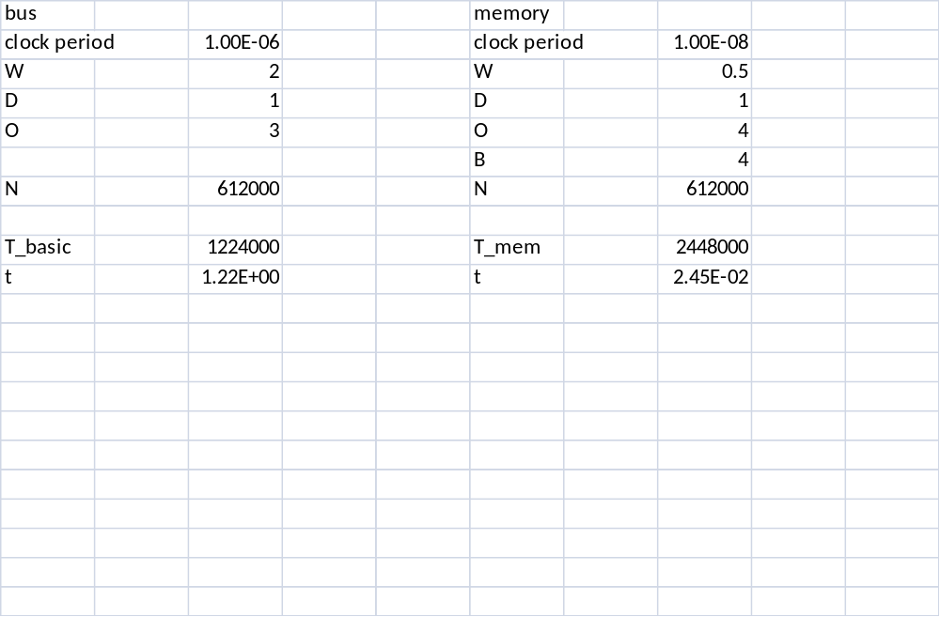
Performance spreadsheet
© 2008 Wayne Wolf
Overheads for Computers as Components 2nd ed.

Slide 20
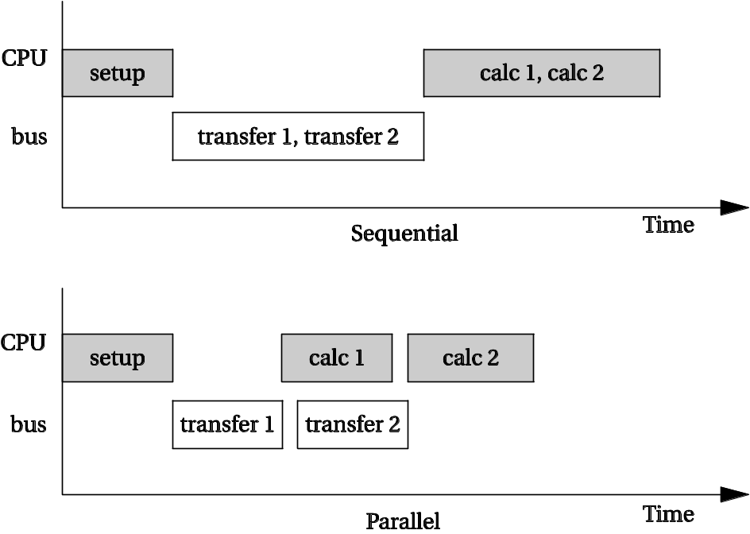
Parallelism
Speed things up by running several units at once.
DMA provides parallelism if CPU doesn’t need the bus:
  DMA + bus.
  CPU.
© 2008 Wayne Wolf
Overheads for Computers as Components 2nd ed.

Slide 21
Bus-Based Computer Systems
Example: alarm clock
© 2008 Wayne Wolf
Overheads for Computers as Components 2nd ed.

Slide 22
Alarm clock interface
Alarm on
Alarm off
buzzer
PM
Alarm
ready
light
set
time
set
alarm
hour
minute
button
© 2008 Wayne Wolf
Overheads for Computers as Components 2nd ed.

Slide 23
Loop tiling
Breaks one loop into a nest of loops.
Changes order of accesses within array.
  Changes cache behavior.
© 2008 Wayne Wolf
Overheads for Computers as Components 2nd ed.

Slide 24
Instruction scheduling
Non-pipelined machines do not need instruction scheduling: any order of instructions that satisfies data dependencies runs equally fast.
In pipelined machines, execution time of one instruction depends on the nearby instructions: opcode, operands.
© 2008 Wayne Wolf
Overheads for Computers as Components 2nd ed.

Slide 25
Reservation table
A reservation table relates instructions/time to CPU resources.
Time/instr A B
instr1 X
instr2 X X
instr3 X
instr4 X
© 2008 Wayne Wolf
Overheads for Computers as Components 2nd ed.

Slide 26
Software pipelining
Schedules instructions across loop iterations.
Reduces instruction latency in iteration i by inserting instructions from iteration i+1.
© 2008 Wayne Wolf
Overheads for Computers as Components 2nd ed.

Slide 27
Program design and analysis
Program-level performance analysis.
Optimizing for:
  Execution time.
  Energy/power.
  Program size.
Program validation and testing.
© 2008 Wayne Wolf
Overheads for Computers as Components 2nd ed.

Slide 28
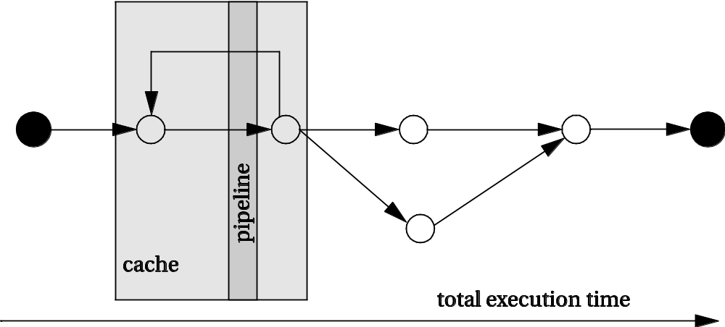
Program-level performance analysis
Need to understand performance in detail:
  Real-time behavior, not just typical.
  On complex platforms.
Program performance ≠ CPU performance:
  Pipeline, cache are windows into program.
  We must analyze the entire program.
© 2008 Wayne Wolf
Overheads for Computers as Components 2nd ed.

Slide 29
Complexities of program performance
Varies with input data:
  Different-length paths.
Cache effects.
Instruction-level performance variations:
  Pipeline interlocks.
  Fetch times.
© 2008 Wayne Wolf
Overheads for Computers as Components 2nd ed.

Slide 30
How to measure program performance
Simulate execution of the CPU.
  Makes CPU state visible.
Measure on real CPU using timer.
  Requires modifying the program to control the timer.
Measure on real CPU using logic analyzer.
  Requires events visible on the pins.
© 2008 Wayne Wolf
Overheads for Computers as Components 2nd ed.

Slide 31
Program performance metrics
Average-case execution time.
  Typically used in application programming.
Worst-case execution time.
  A component in deadline satisfaction.
Best-case execution time.
  Task-level interactions can cause best-case program behavior to result in worst-case system behavior.
© 2008 Wayne Wolf
Overheads for Computers as Components 2nd ed.

Slide 32
Elements of program performance
Basic program execution time formula:
  execution time = program path + instruction timing
Solving these problems independently helps simplify analysis.
  Easier to separate on simpler CPUs.
Accurate performance analysis requires:
  Assembly/binary code.
  Execution platform.
© 2008 Wayne Wolf
Overheads for Computers as Components 2nd ed.

Slide 33
Instruction timing
Not all instructions take the same amount of time.
  Multi-cycle instructions.
  Fetches.
Execution times of instructions are not independent.
  Pipeline interlocks.
  Cache effects.
Execution times may vary with operand value.
  Floating-point operations.
  Some multi-cycle integer operations.
© 2008 Wayne Wolf
Overheads for Computers as Components 2nd ed.

Slide 34
Mesaurement-driven performance analysis
Not so easy as it sounds:
  Must actually have access to the CPU.
  Must know data inputs that give worst/best case performance.
  Must make state visible.
Still an important method for performance analysis.
© 2008 Wayne Wolf
Overheads for Computers as Components 2nd ed.

Slide 35
Performance optimization motivation
Embedded systems must often meet deadlines.
  Faster may not be fast enough.
Need to be able to analyze execution time.
  Worst-case, not typical.
Need techniques for reliably improving execution time.
© 2008 Wayne Wolf
Overheads for Computers as Components 2nd ed.

Slide 36
Programs and performance analysis
Best results come from analyzing optimized instructions, not high-level language code:
  non-obvious translations of HLL statements into instructions;
  code may move;
  cache effects are hard to predict.
© 2008 Wayne Wolf
Overheads for Computers as Components 2nd ed.

Slide 37
Loop optimizations
Loops are good targets for optimization.
Basic loop optimizations:
  code motion;
  induction-variable elimination;
  strength reduction (x*2 -> x<<1).
© 2008 Wayne Wolf
Overheads for Computers as Components 2nd ed.

Slide 38
Optimizing for energy
First-order optimization:
  high performance = low energy.
Not many instructions trade speed for energy.
© 2008 Wayne Wolf
Overheads for Computers as Components 2nd ed.

Slide 39
Optimizing for energy, cont’d.
Use registers efficiently.
Identify and eliminate cache conflicts.
Moderate loop unrolling eliminates some loop overhead instructions.
Eliminate pipeline stalls.
Inlining procedures may help: reduces linkage, but may increase cache thrashing.
© 2008 Wayne Wolf
Overheads for Computers as Components 2nd ed.

Slide 40
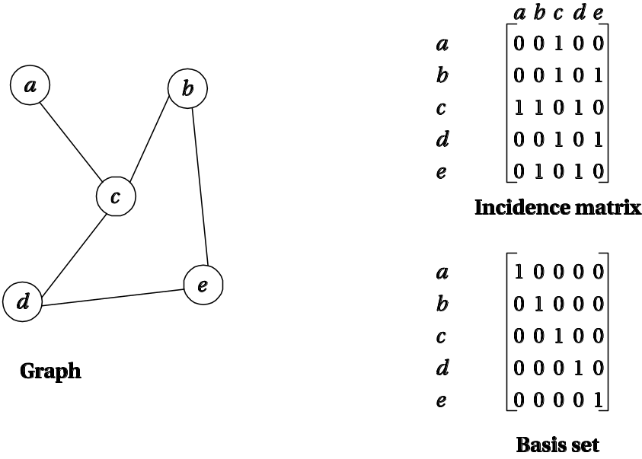
Basis paths
Approximate CDFG with undirected graph.
Undirected graphs have basis paths:
  All paths are linear combinations of basis paths.
© 2008 Wayne Wolf
Overheads for Computers as Components 2nd ed.

Slide 41
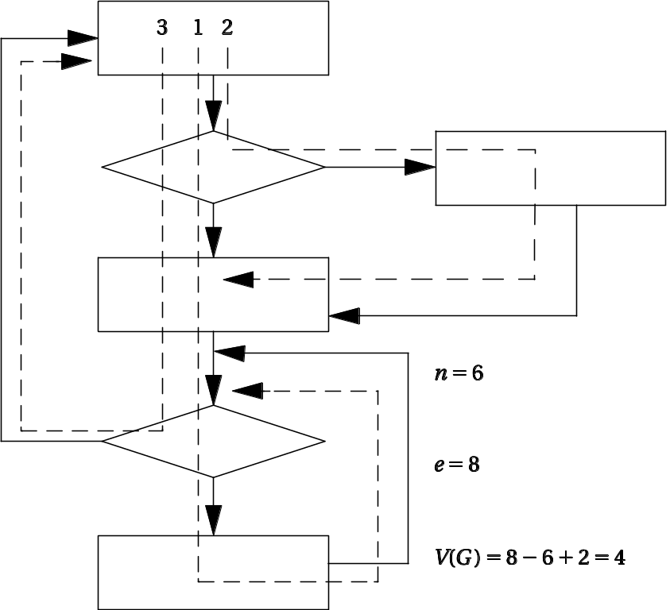
Cyclomatic complexity
Cyclomatic complexity is a bound on the size of basis sets:
  e = # edges
  n = # nodes
  p = number of graph components
  M = e – n + 2p.
© 2008 Wayne Wolf
Overheads for Computers as Components 2nd ed.

Slide 42
Branch testing
Heuristic for testing branches.
  Exercise true and false branches of conditional.
  Exercise every simple condition at least once.
© 2008 Wayne Wolf
Overheads for Computers as Components 2nd ed.

Slide 43
Branch testing example
Correct:
  if (a || (b >= c)) { printf(“OK\n”); }
Incorrect:
  if (a && (b >= c)) { printf(“OK\n”); }
Test:
  a = F
  (b >=c) = T
Example:
  Correct: [0 || (3 >= 2)] = T
  Incorrect: [0 && (3 >= 2)] = F
© 2008 Wayne Wolf
Overheads for Computers as Components 2nd ed.

Slide 44
Another branch testing example
Correct:
  if ((x == good_pointer) && x->field1 == 3)) { printf(“got the value\n”); }
Incorrect:
    if ((x = good_pointer) && x->field1 == 3)) { printf(“got the value\n”); }
Incorrect code changes pointer.
  Assignment returns new LHS in C.
Test that catches error:
  (x != good_pointer) && x->field1 = 3)
© 2008 Wayne Wolf
Overheads for Computers as Components 2nd ed.

Slide 45
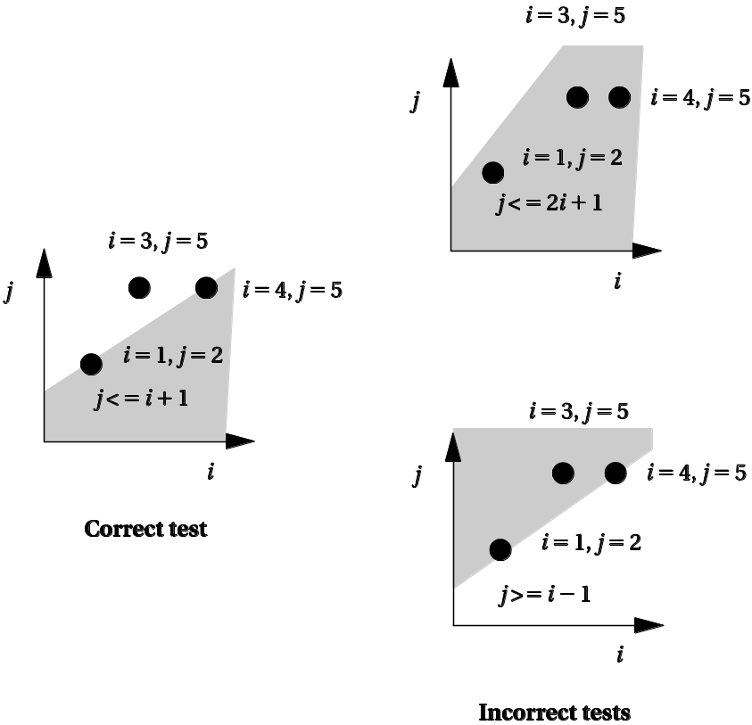
Domain testing
Heuristic test for linear inequalities.
Test on each side + boundary of inequality.
© 2008 Wayne Wolf
Overheads for Computers as Components 2nd ed.

Slide 46
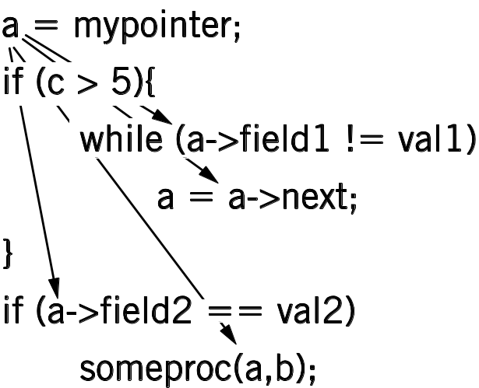
Def-use pairs
Variable def-use:
  Def when value is assigned (defined).
  Use when used on right-hand side.
Exercise each def-use pair.
  Requires testing correct path.
© 2008 Wayne Wolf
Overheads for Computers as Components 2nd ed.

Slide 47
Loop testing
Loops need specialized tests to be tested efficiently.
Heuristic testing strategy:
  Skip loop entirely.
  One loop iteration.
  Two loop iterations.
  # iterations much below max.
  n-1, n, n+1 iterations where n is max.
© 2008 Wayne Wolf
Overheads for Computers as Components 2nd ed.

Slide 48
Theory of operation
Frequency-shift keying:
  separate frequencies for 0 and 1.
0
1
time
© 2008 Wayne Wolf
Overheads for Computers as Components 2nd ed.

Slide 49
FSK encoding
Generate waveforms based on current bit:
bit-controlled
waveform
generator
0110101
© 2008 Wayne Wolf
Overheads for Computers as Components 2nd ed.

Slide 50
FSK decoding
zero filter
detector
0 bit
A/D converter
one filter
detector
1 bit
© 2008 Wayne Wolf
Overheads for Computers as Components 2nd ed.

Slide 51
Transmission scheme
Send data in 8-bit bytes. Arbitrary spacing between bytes.
Byte starts with 0 start bit.
Receiver measures length of start bit to synchronize itself to remaining 8 bits.
start (0)
bit 1
bit 2
bit 3
bit 8
...
© 2008 Wayne Wolf
Overheads for Computers as Components 2nd ed.

Slide 52
System architecture
Interrupt handlers for samples:
  input and output.
Transmitter.
Receiver.
© 2008 Wayne Wolf
Overheads for Computers as Components 2nd ed.

Slide 53
Transmitter
Waveform generation by table lookup.
  float sine_wave[N_SAMP] = { 0.0, 0.5, 0.866, 1, 0.866, 0.5, 0.0, -0.5, -0.866, -1.0, -0.866, -0.5, 0};
time
© 2008 Wayne Wolf
Overheads for Computers as Components 2nd ed.

Slide 54
Receiver
Filters (FIR for simplicity) use circular buffers to hold data.
Timer measures bit length.
State machine recognizes start bits, data bits.
© 2008 Wayne Wolf
Overheads for Computers as Components 2nd ed.

Slide 55
Hardware platform
CPU.
A/D converter.
D/A converter.
Timer.
© 2008 Wayne Wolf
Overheads for Computers as Components 2nd ed.

Slide 56
Why multiple processes?
Multiple tasks means multiple processes.
Processes help with timing complexity:
  multiple rates
    multimedia
    automotive
  asynchronous input
    user interfaces
    communication systems
© 2008 Wayne Wolf
Overheads for Computers as Components 2nd ed.

Slide 57
Multi-rate systems
Tasks may be synchronous or asynchronous.
Synchronous tasks may recur at different rates.
Processes run at different rates based on computational needs of the tasks.
© 2008 Wayne Wolf
Overheads for Computers as Components 2nd ed.

Slide 58
Example: engine control
Tasks:
  spark control
  crankshaft sensing
  fuel/air mixture
  oxygen sensor
  Kalman filter
engine
controller
© 2008 Wayne Wolf
Overheads for Computers as Components 2nd ed.

Slide 59
Typical rates in engine controllers
Variable | Full range time (ms) | Update period (ms)
Engine spark timing | 300 | 2
Throttle | 40 | 2
Air flow | 30 | 4
Battery voltage | 80 | 4
Fuel flow | 250 | 10
Recycled exhaust gas | 500 | 25
Status switches | 100 | 20
Air temperature | Seconds | 400
Barometric pressure | Seconds | 1000
Spark (dwell) | 10 | 1
Fuel adjustment | 80 | 8
Carburetor | 500 | 25
Mode actuators | 100 | 100
© 2008 Wayne Wolf
Overheads for Computers as Components 2nd ed.

Slide 60
Real-time systems
Perform a computation to conform to external timing constraints.
Deadline frequency:
  Periodic.
  Aperiodic.
Deadline type:
  Hard: failure to meet deadline causes system failure.
  Soft: failure to meet deadline causes degraded response.
  Firm: late response is useless but some late responses can be tolerated.
© 2008 Wayne Wolf
Overheads for Computers as Components 2nd ed.

Slide 61
Timing specifications on processes
Release time: time at which process becomes ready.
Deadline: time at which process must finish.
© 2008 Wayne Wolf
Overheads for Computers as Components 2nd ed.

Slide 62
Release times and deadlines
deadline
deadline
P1
P1
P1
time
initiating
event
period
period
aperiodic process
periodic process initiated
at start of period
© 2008 Wayne Wolf
Overheads for Computers as Components 2nd ed.

Slide 63
Rate requirements on processes
Period: interval between process activations.
Rate: reciprocal of period.
Initiatino rate may be higher than period---several copies of process run at once.
CPU 1
P1₁
CPU 2
P1₂
CPU 3
P1₃
CPU 4
P1₄
time
© 2008 Wayne Wolf
Overheads for Computers as Components 2nd ed.

Slide 64
Task graphs
Tasks may have data dependencies---must execute in certain order.
Task graph shows data/control dependencies between processes.
Task: connected set of processes.
Task set: One or more tasks.
P1
P2
P5
P3
P6
P4
task 1
task 2
task set
© 2008 Wayne Wolf
Overheads for Computers as Components 2nd ed.

Slide 65
Communication between tasks
Task graph assumes that all processes in each task run at the same rate, tasks do not communicate.
In reality, some amount of inter-task communication is necessary.
  It’s hard to require immediate response for multi-rate communication.
MPEG system layer
MPEG audio
MPEG video
© 2008 Wayne Wolf
Overheads for Computers as Components 2nd ed.

Slide 66
Utilization
CPU utilization:
  Fraction of the CPU that is doing useful work.
  Often calculated assuming no scheduling overhead.
Utilization:
  U = (CPU time for useful work)/ (total available CPU time)
    = [ Σ _{t1 ≤ t ≤ t2} T(t) ] / [t2 – t1]
    = T/t
© 2008 Wayne Wolf
Overheads for Computers as Components 2nd ed.

Slide 67
Simple processor feasibility
Assume:
  No resource conflicts.
  Constant process execution times.
Require:
  T ≥ Σ_{i} T_{i}
  Can’t use more than 100% of the CPU.
T₁
T₂
T₃
T
© 2008 Wayne Wolf
Overheads for Computers as Components 2nd ed.

Slide 68
Hyperperiod
Hyperperiod: least common multiple (LCM) of the task periods.
Must look at the hyperperiod schedule to find all task interactions.
Hyperperiod can be very long if task periods are not chosen carefully.
© 2008 Wayne Wolf
Overheads for Computers as Components 2nd ed.

Slide 69
Hyperperiod example
Long hyperperiod:
  P1 7 ms.
  P2 11 ms.
  P3 15 ms.
  LCM = 1155 ms.
Shorter hyperperiod:
  P1 8 ms.
  P2 12 ms.
  P3 16 ms.
  LCM = 96 ms.
© 2008 Wayne Wolf
Overheads for Computers as Components 2nd ed.

Slide 70
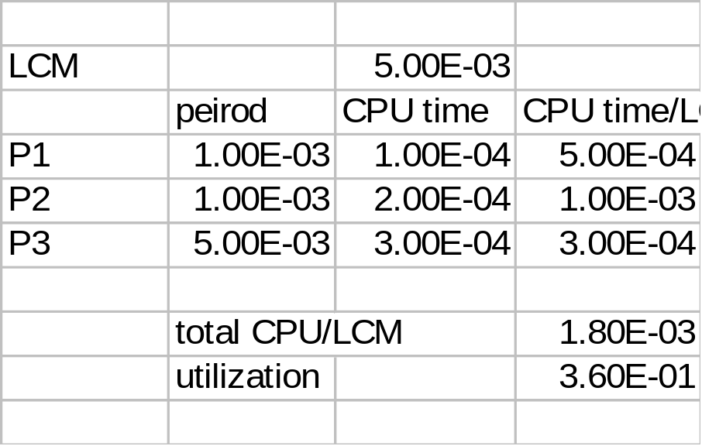
Simple processor feasibility example
P1 period 1 ms, CPU time 0.1 ms.
P2 period 1 ms, CPU time 0.2 ms.
P3 period 5 ms, CPU time 0.3 ms.
© 2008 Wayne Wolf
Overheads for Computers as Components 2nd ed.

Slide 71
Cyclostatic/TDMA
Schedule in time slots.
  Same process activation irrespective of workload.
Time slots may be equal size or unequal.
T₁
T₂
T₃
T₁
T₂
T₃
P
P
© 2008 Wayne Wolf
Overheads for Computers as Components 2nd ed.

Slide 72
TDMA assumptions
Schedule based on least common multiple (LCM) of the process periods.
Trivial scheduler -> very small scheduling overhead.
P₁
P₁
P₁
P₂
P₂
P_{LCM}
© 2008 Wayne Wolf
Overheads for Computers as Components 2nd ed.

Slide 73
TDMA schedulability
Always same CPU utilization (assuming constant process execution times).
Can’t handle unexpected loads.
  Must schedule a time slot for aperiodic events.
© 2008 Wayne Wolf
Overheads for Computers as Components 2nd ed.

Slide 74
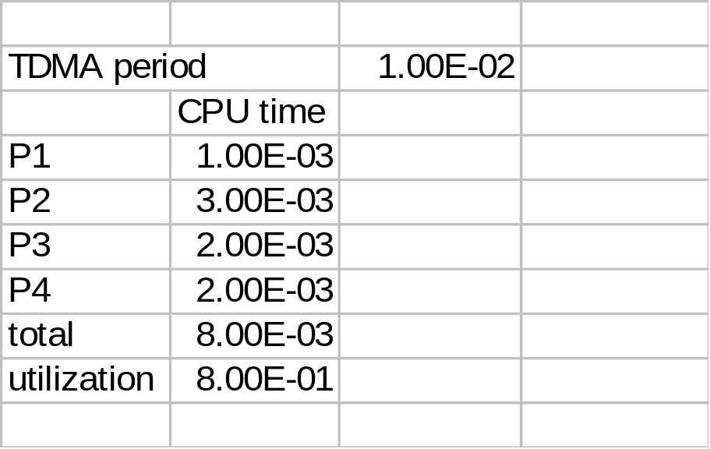
TDMA schedulability example
TDMA period = 10 ms.
P1 CPU time 1 ms.
P2 CPU time 3 ms.
P3 CPU time 2 ms.
P4 CPU time 2 ms.
© 2008 Wayne Wolf
Overheads for Computers as Components 2nd ed.

Slide 75
Round-robin
Schedule process only if ready.
  Always test processes in the same order.
Variations:
  Constant system period.
  Start round-robin again after finishing a round.
T₁
T₂
T₃
T₂
T₃
P
P
© 2008 Wayne Wolf
Overheads for Computers as Components 2nd ed.

Slide 76
Round-robin assumptions
Schedule based on least common multiple (LCM) of the process periods.
Best done with equal time slots for processes.
Simple scheduler -> low scheduling overhead.
  Can be implemented in hardware.
© 2008 Wayne Wolf
Overheads for Computers as Components 2nd ed.

Slide 77
Round-robin schedulability
Can bound maximum CPU load.
  May leave unused CPU cycles.
Can be adapted to handle unexpected load.
  Use time slots at end of period.
© 2008 Wayne Wolf
Overheads for Computers as Components 2nd ed.

Slide 78
Schedulability and overhead
The scheduling process consumes CPU time.
  Not all CPU time is available for processes.
Scheduling overhead must be taken into account for exact schedule.
  May be ignored if it is a small fraction of total execution time.
© 2008 Wayne Wolf
Overheads for Computers as Components 2nd ed.

Slide 79
Running periodic processes
Need code to control execution of processes.
Simplest implementation: process = subroutine.
© 2008 Wayne Wolf
Overheads for Computers as Components 2nd ed.

Slide 80
Interprocess communication
Interprocess communication (IPC): OS provides mechanisms so that processes can pass data.
Two types of semantics:
  blocking: sending process waits for response;
  non-blocking: sending process continues.
© 2000 Morgan Kaufman
Overheads for Computers as Components

Slide 81
Race condition in shared memory
Problem when two CPUs try to write the same location:
  CPU 1 reads flag and sees 0.
  CPU 2 reads flag and sees 0.
  CPU 1 sets flag to one and writes location.
  CPU 2 sets flag to one and overwrites location.
© 2000 Morgan Kaufman
Overheads for Computers as Components

Slide 82
Atomic test-and-set
Problem can be solved with an atomic test-and-set:
  single bus operation reads memory location, tests it, writes it.
ARM test-and-set provided by SWP:
    ADR r0,SEMAPHORE
    LDR r1,#1
    GETFLAG SWP r1,r1,[r0]
    BNZ GETFLAG
© 2000 Morgan Kaufman
Overheads for Computers as Components

Slide 83
Critical regions
Critical region: section of code that cannot be interrupted by another process.
Examples:
  writing shared memory;
  accessing I/O device.
© 2000 Morgan Kaufman
Overheads for Computers as Components

Slide 84
Semaphores
Semaphore: OS primitive for controlling access to critical regions.
Protocol:
  Get access to semaphore with P().
  Perform critical region operations.
  Release semaphore with V().
© 2000 Morgan Kaufman
Overheads for Computers as Components

Slide 85
Message passing
Message passing on a network:
CPU 1
CPU 2
message
message
message
© 2000 Morgan Kaufman
Overheads for Computers as Components

Slide 86
Process data dependencies
One process may not be able to start until another finishes.
Data dependencies defined in a task graph.
All processes in one task run at the same rate.
P1
P2
P3
P4
© 2000 Morgan Kaufman
Overheads for Computers as Components

Slide 87
Other operating system functions
Date/time.
File system.
Networking.
Security.
© 2000 Morgan Kaufman
Overheads for Computers as Components

Slide 88
Processes and operating systems
Scheduling policies:
  RMS;
  EDF.
Scheduling modeling assumptions.
© 2008 Wayne Wolf
Overheads for Computers as Components 2nd ed.

Slide 89
Metrics
How do we evaluate a scheduling policy:
  Ability to satisfy all deadlines.
  CPU utilization---percentage of time devoted to useful work.
  Scheduling overhead---time required to make scheduling decision.
© 2008 Wayne Wolf
Overheads for Computers as Components 2nd ed.

Slide 90
Rate monotonic scheduling
RMS (Liu and Layland): widely-used, analyzable scheduling policy.
Analysis is known as Rate Monotonic Analysis (RMA).
© 2008 Wayne Wolf
Overheads for Computers as Components 2nd ed.

Slide 91
RMA model
All process run on single CPU.
Zero context switch time.
No data dependencies between processes.
Process execution time is constant.
Deadline is at end of period.
Highest-priority ready process runs.
© 2008 Wayne Wolf
Overheads for Computers as Components 2nd ed.

Slide 92
Process parameters
T_{i} is computation time of process i; τ_{i} is period of process i.
period τ_{i}
Pi
computation time T_{i}
© 2008 Wayne Wolf
Overheads for Computers as Components 2nd ed.

Slide 93
Rate-monotonic analysis
Response time: time required to finish process.
Critical instant: scheduling state that gives worst response time.
Critical instant occurs when all higher-priority processes are ready to execute.
© 2008 Wayne Wolf
Overheads for Computers as Components 2nd ed.

Slide 94
Critical instant
interfering processes
P1
P1
P1
P1
P1
P2
P2
P2
P3
P3
critical
instant
P4
© 2008 Wayne Wolf
Overheads for Computers as Components 2nd ed.

Slide 95
RMS priorities
Optimal (fixed) priority assignment:
  shortest-period process gets highest priority;
  priority inversely proportional to period;
  break ties arbitrarily.
No fixed-priority scheme does better.
© 2008 Wayne Wolf
Overheads for Computers as Components 2nd ed.

Slide 96
RMS example
P2 period
P2
P1 period
P1
P1
P1
0
5
10
time
© 2008 Wayne Wolf
Overheads for Computers as Components 2nd ed.

Slide 97
RMS CPU utilization
Utilization for n processes is
  Σ _{i} T_{i} / τ_{i}
As number of tasks approaches infinity, maximum utilization approaches 69%.
© 2008 Wayne Wolf
Overheads for Computers as Components 2nd ed.

Slide 98
RMS CPU utilization, cont’d.
RMS cannot use 100% of CPU, even with zero context switch overhead.
Must keep idle cycles available to handle worst-case scenario.
However, RMS guarantees all processes will always meet their deadlines.
© 2008 Wayne Wolf
Overheads for Computers as Components 2nd ed.

Slide 99
RMS implementation
Efficient implementation:
  scan processes;
  choose highest-priority active process.
© 2008 Wayne Wolf
Overheads for Computers as Components 2nd ed.

Slide 100
Context-switching time
Non-zero context switch time can push limits of a tight schedule.
Hard to calculate effects---depends on order of context switches.
In practice, OS context switch overhead is small (hundreds of clock cycles) relative to many common task periods (ms – μs).
© 2008 Wayne Wolf
Overheads for Computers as Components 2nd ed.

Slide 101
Processes and operating systems
Interprocess communication.
Operating system performance.
Power management.
© 2008 Wayne Wolf
Overheads for Computers as Components 2nd ed.

Slide 102
Interprocess communication
OS provides interprocess communication mechanisms:
  various efficiencies;
  communication power.
© 2008 Wayne Wolf
Overheads for Computers as Components 2nd ed.

Slide 103
Interprocess communication
Interprocess communication (IPC): OS provides mechanisms so that processes can pass data.
Two types of semantics:
  blocking: sending process waits for response;
  non-blocking: sending process continues.
© 2008 Wayne Wolf
Overheads for Computers as Components 2nd ed.

Slide 104
IPC styles
Shared memory:
  processes have some memory in common;
  must cooperate to avoid destroying/missing messages.
Message passing:
  processes send messages along a communication channel---no common address space.
© 2008 Wayne Wolf
Overheads for Computers as Components 2nd ed.

Slide 105
Shared memory
Shared memory on a bus:
memory
CPU 1
CPU 2
© 2008 Wayne Wolf
Overheads for Computers as Components 2nd ed.

Slide 106
Race condition in shared memory
Problem when two CPUs try to write the same location:
  CPU 1 reads flag and sees 0.
  CPU 2 reads flag and sees 0.
  CPU 1 sets flag to one and writes location.
  CPU 2 sets flag to one and overwrites location.
© 2008 Wayne Wolf
Overheads for Computers as Components 2nd ed.

Slide 107
Atomic test-and-set
Problem can be solved with an atomic test-and-set:
  single bus operation reads memory location, tests it, writes it.
ARM test-and-set provided by SWP:
    ADR r0,SEMAPHORE
    LDR r1,#1
    GETFLAG SWP r1,r1,[r0]
    BNZ GETFLAG
© 2008 Wayne Wolf
Overheads for Computers as Components 2nd ed.

Slide 108
Critical regions
Critical region: section of code that cannot be interrupted by another process.
Examples:
  writing shared memory;
  accessing I/O device.
© 2008 Wayne Wolf
Overheads for Computers as Components 2nd ed.

Slide 109
Semaphores
Semaphore: OS primitive for controlling access to critical regions.
Protocol:
  Get access to semaphore with P().
  Perform critical region operations.
  Release semaphore with V().
© 2008 Wayne Wolf
Overheads for Computers as Components 2nd ed.

Slide 110
Message passing
Message passing on a network:
CPU 1
CPU 2
message
message
message
© 2008 Wayne Wolf
Overheads for Computers as Components 2nd ed.

Slide 111
Process data dependencies
One process may not be able to start until another finishes.
Data dependencies defined in a task graph.
All processes in one task run at the same rate.
P1
P2
P3
P4
© 2008 Wayne Wolf
Overheads for Computers as Components 2nd ed.

Slide 112
Power optimization
Power management: determining how system resources are scheduled/used to control power consumption.
OS can manage for power just as it manages for time.
OS reduces power by shutting down units.
  May have partial shutdown modes.
© 2008 Wayne Wolf
Overheads for Computers as Components 2nd ed.

Slide 113
Power management and performance
Power management and performance are often at odds.
Entering power-down mode consumes
  energy,
  time.
Leaving power-down mode consumes
  energy,
  time.
© 2008 Wayne Wolf
Overheads for Computers as Components 2nd ed.

Slide 114
Simple power management policies
Request-driven: power up once request is received. Adds delay to response.
Predictive shutdown: try to predict how long you have before next request.
  May start up in advance of request in anticipation of a new request.
  If you predict wrong, you will incur additional delay while starting up.
© 2008 Wayne Wolf
Overheads for Computers as Components 2nd ed.

Slide 115
Probabilistic shutdown
Assume service requests are probabilistic.
Optimize expected values:
  power consumption;
  response time.
Simple probabilistic: shut down after time T_{on}, turn back on after waiting for T_{off}.
© 2008 Wayne Wolf
Overheads for Computers as Components 2nd ed.

Slide 116
Component design and testing
Must test performance as well as testing.
  Compression time shouldn’t dominate other tasks.
Test for error conditions:
  memory overflow;
  try to delete empty message set, etc.
© 2008 Wayne Wolf
Overheads for Computers as Components 2nd ed.

Slide 117
System integration and testing
Can test partial integration on host platform; full testing requires integration on target platform.
Simulate phone line for tests:
  it’s legal;
  easier to produce test conditions.
© 2008 Wayne Wolf
Overheads for Computers as Components 2nd ed.

Slide 118
Multiprocessors
Why multiprocessors?
CPUs and accelerators.
Multiprocessor performance analysis.
© 2008 Wayne Wolf
Overheads for Computers as Components 2nd ed.

Slide 119
Why multiprocessors?
Better cost/performance.
  Match each CPU to its tasks or use custom logic (smaller, cheaper).
  CPU cost is a non-linear function of performance.
cost
performance
© 2008 Wayne Wolf
Overheads for Computers as Components 2nd ed.

Slide 120
Why multiprocessors? cont’d.
Better real-time performance.
  Put time-critical functions on less-loaded processing elements.
  Remember RMS utilization---extra CPU cycles must be reserved to meet deadlines.
cost
deadline w.
RMS overhead
deadline
performance
© 2008 Wayne Wolf
Overheads for Computers as Components 2nd ed.

Slide 121
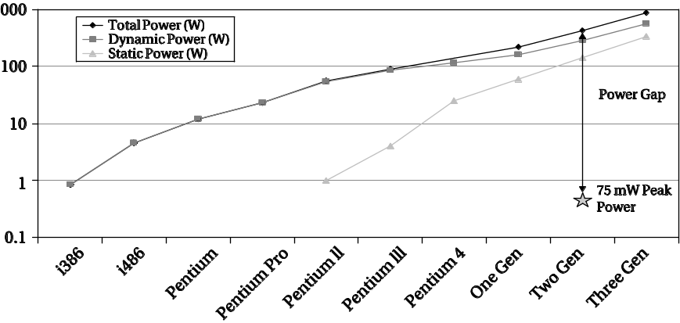
Why multiprocessors? cont’d.
Using specialized processors or custom logic saves power.
Desktop uniprocessors are not power-efficient enough for battery-powered applications.
[Aus04] © 2004 IEEE Computer Society
© 2008 Wayne Wolf
Overheads for Computers as Components 2nd ed.

Slide 122
Why multiprocessors? cont’d.
Good for processing I/O in real-time.
May consume less energy.
May be better at streaming data.
May not be able to do all the work on even the largest single CPU.
© 2008 Wayne Wolf
Overheads for Computers as Components 2nd ed.

Slide 123
Accelerated systems
Use additional computational unit dedicated to some functions?
  Hardwired logic.
  Extra CPU.
Hardware/software co-design: joint design of hardware and software architectures.
© 2008 Wayne Wolf
Overheads for Computers as Components 2nd ed.

Slide 124
Accelerated system architecture
accelerator
request
CPU
result
data
data
memory
I/O
© 2008 Wayne Wolf
Overheads for Computers as Components 2nd ed.

Slide 125
Accelerator vs. co-processor
A co-processor executes instructions.
  Instructions are dispatched by the CPU.
An accelerator appears as a device on the bus.
  The accelerator is controlled by registers.
© 2008 Wayne Wolf
Overheads for Computers as Components 2nd ed.

Slide 126
Accelerator implementations
Application-specific integrated circuit.
Field-programmable gate array (FPGA).
Standard component.
  Example: graphics processor.
© 2008 Wayne Wolf
Overheads for Computers as Components 2nd ed.

Slide 127
System design tasks
Design a heterogeneous multiprocessor architecture.
  Processing element (PE): CPU, accelerator, etc.
Program the system.
© 2008 Wayne Wolf
Overheads for Computers as Components 2nd ed.

Slide 128
Accelerated system design
First, determine that the system really needs to be accelerated.
  How much faster is the accelerator on the core function?
  How much data transfer overhead?
Design the accelerator itself.
Design CPU interface to accelerator.
© 2008 Wayne Wolf
Overheads for Computers as Components 2nd ed.

Slide 129
Accelerated system platforms
Several off-the-shelf boards are available for acceleration in PCs:
  FPGA-based core;
  PC bus interface.
© 2008 Wayne Wolf
Overheads for Computers as Components 2nd ed.

Slide 130
Accelerator/CPU interface
Accelerator registers provide control registers for CPU.
Data registers can be used for small data objects.
Accelerator may include special-purpose read/write logic.
  Especially valuable for large data transfers.
© 2008 Wayne Wolf
Overheads for Computers as Components 2nd ed.

Slide 131
System integration and debugging
Try to debug the CPU/accelerator interface separately from the accelerator core.
Build scaffolding to test the accelerator.
Hardware/software co-simulation can be useful.
© 2008 Wayne Wolf
Overheads for Computers as Components 2nd ed.

Slide 132
Caching problems
Main memory provides the primary data transfer mechanism to the accelerator.
Programs must ensure that caching does not invalidate main memory data.
  CPU reads location S.
  Accelerator writes location S.
  CPU writes location S.
BAD
© 2008 Wayne Wolf
Overheads for Computers as Components 2nd ed.

Slide 133
Synchronization
As with cache, main memory writes to shared memory may cause invalidation:
  CPU reads S.
  Accelerator writes S.
  CPU reads S.
© 2008 Wayne Wolf
Overheads for Computers as Components 2nd ed.

Slide 134
Multiprocessor performance analysis
Effects of parallelism (and lack of it):
  Processes.
  CPU and bus.
  Multiple processors.
© 2008 Wayne Wolf
Overheads for Computers as Components 2nd ed.

Slide 135
Accelerator speedup
Critical parameter is speedup: how much faster is the system with the accelerator?
Must take into account:
  Accelerator execution time.
  Data transfer time.
  Synchronization with the master CPU.
© 2008 Wayne Wolf
Overheads for Computers as Components 2nd ed.

Slide 136
Accelerator execution time
Total accelerator execution time:
  t_{accel} = t_{in} + t_{x} + t_{out}
Data input
Data output
Accelerated
computation
© 2008 Wayne Wolf
Overheads for Computers as Components 2nd ed.

Slide 137
Accelerator speedup
Assume loop is executed n times.
Compare accelerated system to non-accelerated system:
  S = n(t_{CPU} - t_{accel})
  = n[t_{CPU} - (t_{in} + t_{x} + t_{out})]
Execution time on CPU
© 2008 Wayne Wolf
Overheads for Computers as Components 2nd ed.

Slide 138
Single- vs. multi-threaded
One critical factor is available parallelism:
  single-threaded/blocking: CPU waits for accelerator;
  multithreaded/non-blocking: CPU continues to execute along with accelerator.
To multithread, CPU must have useful work to do.
  But software must also support multithreading.
© 2008 Wayne Wolf
Overheads for Computers as Components 2nd ed.

Slide 139
Total execution time
Single-threaded:
Multi-threaded:
P1
P1
P2
A1
P2
A1
P3
P3
P4
P4
© 2008 Wayne Wolf
Overheads for Computers as Components 2nd ed.

Slide 140
Execution time analysis
Single-threaded:
  Count execution time of all component processes.
Multi-threaded:
  Find longest path through execution.
© 2008 Wayne Wolf
Overheads for Computers as Components 2nd ed.

Slide 141
Sources of parallelism
Overlap I/O and accelerator computation.
  Perform operations in batches, read in second batch of data while computing on first batch.
Find other work to do on the CPU.
  May reschedule operations to move work after accelerator initiation.
© 2008 Wayne Wolf
Overheads for Computers as Components 2nd ed.

Slide 142
Data input/output times
Bus transactions include:
  flushing register/cache values to main memory;
  time required for CPU to set up transaction;
  overhead of data transfers by bus packets, handshaking, etc.
© 2008 Wayne Wolf
Overheads for Computers as Components 2nd ed.

Slide 143
Scheduling and allocation
Must:
  schedule operations in time;
  allocate computations to processing elements.
Scheduling and allocation interact, but separating them helps.
  Alternatively allocate, then schedule.
© 2008 Wayne Wolf
Overheads for Computers as Components 2nd ed.

Slide 144
Example: scheduling and allocation
P1
P2
M1
M2
d1
d2
P3
Task graph
Hardware platform
© 2008 Wayne Wolf
Overheads for Computers as Components 2nd ed.

Slide 145
First design
Allocate P1, P2 -> M1; P3 -> M2.
M1
P1
P1C
P2
P2C
M2
P3
time
© 2008 Wayne Wolf
Overheads for Computers as Components 2nd ed.

Slide 146
Second design
Allocate P1 -> M1; P2, P3 -> M2:
M1
P1
P1C
M2
P2
P3
time
© 2008 Wayne Wolf
Overheads for Computers as Components 2nd ed.

Slide 147
Example: adjusting messages to reduce delay
Task graph:
Network:
execution time
3
3
allocation
P1
P2
M1
M2
M3
d1
d2
P3
4
Transmission time = 4
© 2008 Wayne Wolf
Overheads for Computers as Components 2nd ed.

Slide 148
Initial schedule
M1
P1
M2
P2
M3
P3
network
d1
d2
Time = 15
0
5
10
15
20
time
© 2008 Wayne Wolf
Overheads for Computers as Components 2nd ed.

Slide 149
New design
Modify P3:
  reads one packet of d1, one packet of d2
  computes partial result
  continues to next packet
© 2008 Wayne Wolf
Overheads for Computers as Components 2nd ed.

Slide 150
New schedule
M1
P1
M2
P2
M3
P3
P3
P3
P3
network
d1
d2
d1
d2
d1
d2
d1
d2
Time = 12
0
5
10
15
20
time
© 2008 Wayne Wolf
Overheads for Computers as Components 2nd ed.

Slide 151
Buffering and performance
Buffering may sequentialize operations.
  Next process must wait for data to enter buffer before it can continue.
Buffer policy (queue, RAM) affects available parallelism.
© 2008 Wayne Wolf
Overheads for Computers as Components 2nd ed.

Slide 152
Buffers and latency
Three processes separated by buffers:
B1
A
B2
B
B3
C
© 2008 Wayne Wolf
Overheads for Computers as Components 2nd ed.

Slide 153
Buffers and latency schedules
A[0]
A[1]
…
B[0]
B[1]
…
C[0]
C[1]
…
A[0]
B[0]
C[0]
A[1]
B[1]
C[1]
…
Must wait for
all of A before
getting any B
© 2008 Wayne Wolf
Overheads for Computers as Components 2nd ed.

Slide 154
Multiprocessors
Consumer electronics systems.
Cell phones.
CDs and DVDs.
Audio players.
Digital still cameras.
© 2008 Wayne Wolf
Overheads for Computers as Components 2nd ed.

Slide 155
CSMA/CD
Carrier sense multiple access with collision detection:
  sense collisions;
  exponentially back off in time;
  retransmit.
© 2008 Wayne Wolf
Overheads for Computers as Components 2nd ed.

Slide 156
Exponential back-off times
time
© 2008 Wayne Wolf
Overheads for Computers as Components 2nd ed.

Slide 157
Message delay
Assume:
  single message;
  no contention.
Delay:
  t_{m} = t_{x} + t_{n} + t_{r}
  = xmtr overhead + network xmit time + rcvr overhead
© 2008 Wayne Wolf
Overheads for Computers as Components 2nd ed.

Slide 158
Example: I²C message delay
Network transmission time dominates.
Assume 100 kbits/sec, one 8-bit byte.
Number of bits in packet:
  n_{packet} = start + address + data + stop
  = 1 + 8 + 8 + 1 = 18 bits
Time required to transmit: 1.8 x 10⁻⁴ sec.
20 instructions on 8 MHz controller adds 2.5 x 10⁻⁶ delay on xmtr, rcvr.
© 2008 Wayne Wolf
Overheads for Computers as Components 2nd ed.

Slide 159
Multiple messages
If messages can interfere with each other, analysis is more complex.
Model total message delay:
  t_{y} = t_{d} + t_{m}
  = wait time for network + message delay
© 2008 Wayne Wolf
Overheads for Computers as Components 2nd ed.

Slide 160
Arbitration and delay
Fixed-priority arbitration introduces unbounded delay for all but highest-priority device.
  Unless higher-priority devices are known to have limited rates that allow lower devices to transmit.
Round-robin arbitration introduces bounded delay proportional to N.
© 2008 Wayne Wolf
Overheads for Computers as Components 2nd ed.

Slide 161
Further complications
Acknowledgment time.
Transmission errors.
© 2008 Wayne Wolf
Overheads for Computers as Components 2nd ed.

Slide 162
Priority inversion in networks
In many networks, a packet cannot be interrupted.
Result is priority inversion:
  low-priority message holds up higher-priority message.
Doesn’t cause deadlock, but can slow down important communications.
© 2008 Wayne Wolf
Overheads for Computers as Components 2nd ed.

Slide 163
Multihop networks
In multihop networks, one node receives message, then retransmits to destination (or intermediate).
hop 1
hop 2
A
B
C
Network 1
Network 2
© 2008 Wayne Wolf
Overheads for Computers as Components 2nd ed.

Slide 164
System performance analysis
System analysis is difficult in general.
  multiprocessor performance analysis is hard;
  communication performance analysis is hard.
Simple example: uncertainty in P1 finish time -> uncertainty in P2 start time.
P1
P2
© 2008 Wayne Wolf
Overheads for Computers as Components 2nd ed.

Slide 165
Analysis challenges
P2 and P3 can delay each other, even though they are in separate tasks.
Delays in P1 propagate to P2, then P3, then to P4.
P1
P2
P3
P4
© 2008 Wayne Wolf
Overheads for Computers as Components 2nd ed.

Slide 166
Vehicles as networks
1/3 of cost of car/airplane is electronics/avionics.
Dozens of microprocessors are used throughout the vehicle.
Network applications:
  Vehicle control.
  Instrumentation.
  Communication.
  Passenger entertainment systems.
© 2008 Wayne Wolf
Overheads for Computers as Components 2nd ed.

Slide 167
Avionics
Anything permanently attached to the aircraft must be certified by FAA/national agency.
Traditional architecture uses separate electronics for each instrument/device.
  Line replaceable unit (LRU) can be physically removed and replaced.
Federated architecture shares processors across a subsystem (nav/comm, etc.)
© 2008 Wayne Wolf
Overheads for Computers as Components 2nd ed.

Slide 168
Sensor networks
Wireless networks, small nodes.
Ad hoc networks---organizes itself without system administrator:
  Must be able to declare membership in network, find other networks.
  Must be able to determine routes for data.
  Must update configuration as nodes enter/leave.
© 2008 Wayne Wolf
Overheads for Computers as Components 2nd ed.

